Slide 1
Total Fitness App
4/15/2023
Team Members:
Nicholas Szwed - Product Owner
Batu Salih - Initial ScrumMaster
Vaibhav Honakere
Julio Vasquez-Bonilla
Phudis Rangsisuriyachai

Slide 2
Total Fitness App
Would you like an efficient way to get fit
Tracking a diet seems difficult
Maintaining a consistent exercise routine hard, etc.
We have come up with an app that take cares of both
Keeps track of a daily nutrition intake
Coordinate a workout plan on a given schedule set from the user
Benefits of tracking diet and exercise
Holds you accountable
Allow you to modify and show when diet changes should be made
etc.
Notes:
Vaibhav Honakere
Reasons for why we should make this app
Holds you accountable
Allows for easier modifications and shows when and where diet changes need to be made
Can be used to reflect back on what foods make you feel bloated, what foods give you more energy, and more.
Can easily keep track of protein, carbohydrate, and fat intake
Helps to drive the focus and direction of your programming

Slide 3
Project Scope
Allow users to keep track of their caloric intake and fitness routines
Allow Users to input meals which are then stored and compared to their daily goal.
Allow users to input workout routines and keep track of past workouts
Notes:
Nick

Slide 4
Sprint 1 (2 Weeks)
User stories
[U.S 1.1 ]As a user, I want to be able to access this app through the Internet because keeping track of my workouts and calories is tedious with pen and paper
[U.S 1.2]As a user, I want to create a profile that remembers my data.
[U.S 1.3]As a user, I want to be able to look back on my old data.
Spikes
Set up firebase
Learn MUI
Infrastructure tasks
Setting a gitRepo
Create Welcome page
Notes:
Batu Salih

Slide 5
Sprint 2 (2 Weeks)
User Stories
[U.S 2.1 ] As a potential user, I want to see an impressive home page with info
[U.S 2.2] As a user, I want a clean home page with clear functionality
[U.S 2.3] As a user, I want to be able to edit my information like an email address or other data
[U.S 2.4] As a user, I want a page that clearly displays information regarding nutrition
[U.S 2.5] As a user, I want a page that clearly displays information regarding my workouts
Spikes
Learn firebase
Learn how to call firebase from javascript/typescript
Infrastructure tasks
Create User Home page
Create Nutrition Home
Create Fitness Home
Notes:
Vaibhav Honakere

Slide 6
Sprint 3 (2 Weeks)
Sprint 3 (2 Weeks)
User Stories
[U.S 3.1 ] As a user, I want to be able to enter a meal and see the nutrition breakdown
[U.S 3.2] As a user, I want to be able to create and keep track of workouts
Spikes
Have the user, nutrition, and fitness homepages working properly
Infrastructure tasks
Setting up a connection to the API
Notes:
Batu Salih
Spikes:
Have those pages working so that you can setup API calls to a local database

Slide 7
Sprint 4 (2 Weeks)
User Stories
[U.S 4.1 ]As a User, I want to be able to see information regarding my meals for that day
[U.S 4.2 ]As a User, I want to be able to reuse meals without manually re-entering the data
[U.S 4.3 ]As a user, I want to see the days I worked out along with some info on the workouts
[U.S 4.4 ]As a user, I want to be able to save and reuse old workouts
Spikes
Make sure the frontend and backend work hand and hand
Make multiple requests to the database with no faulty behavior
Notes:
Vaibhav Honakere

Slide 8
Sprint 5 (1 Weeks)
User stories
[U.S 5.1 ]As a user, I want to be able to use the app
[U.S 5.2]As a user, I need to be able to report issues to the dev team
[U.S 5.3]As a dev, I need to know what needs to change according to the user
Spikes
Deploy the app
Test the app
Check the quality of the app (QoL)
Infrastructure tasks
Deploy the app with google
Unit testing
Notes:
Phudis

Slide 9
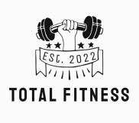
Architecture
This will contain
- Home
- About
- Contact
- Log-in/Sign-in
Welcome
About us
Login
There might be more feature than these in the future…
Forgot password
Create an account
Notes:
Phudis

Slide 10
Architecture
This will contain
Set Profile
like set body-type page
Picture
Profile name
Picture
Profile name
Bio
Bio
Nutrition
Goal
Workout
Calendar
Summary
Goal
Workout
Calendar
Summary
Nutrition
Input Food
Calories goal
Calories:
Calories:
Remaining:
Protein:
We will use MyFitnessPal API
Sugar:
Carbs:
Protein goal
Salt:
Protein: (g)
Remaining:
Input Nutrition
Notes:
Phudis

Slide 11
Architecture
Picture
Profile name
Picture
Profile name
Bio
Bio
Goal
Nutrition
Goal
Workout
Calendar
Summary
Nutrition
Workout
Calendar
Summary
Workout
Calendar
Exercise
SUN | MON | TUE | WED | THU | FRI | SAT
1 | 2 | 3 | 4 | 5 | 6 | 7
8 | 9 | 10 | 11 | 12 | 13 | 14
15 | 16 | 17 | 18 | 19 | 20 | 21
22 | 23 | 24 | 25 | 26 | 27 | 28
29 | 30 | 31
Create Workout
Exercise1:
Set1: Set2: Set3:
User will be able to add
Exercise2:
Set1: Set2: Set3:
Save
Cancel
+
Notes:
Julio

Slide 12
Architecture
Picture
Profile name
Bio
Goal
Nutrition
Workout
Calendar
Summary
Summary
If we finish sooner than what we have in sprint, we will try to add more feature and decorate it…
Notes:
Julio

Slide 13






Technologies
Notes:
Julio

Slide 14
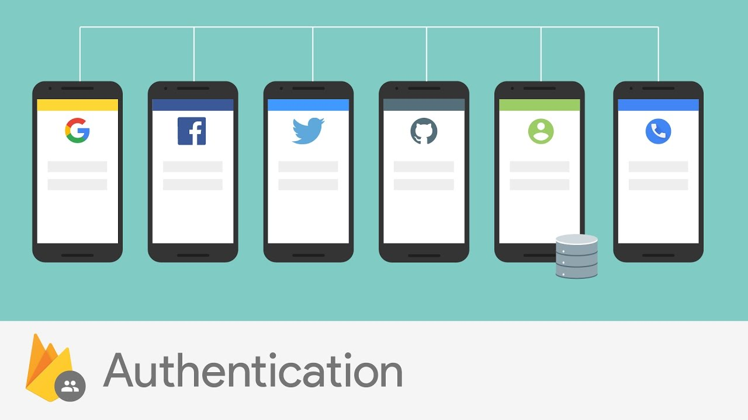
Challenges
Challenge 1: Creating a secure way of saving user data
Given that we need to be able to store multiple users the app must have a method of authenticating those users.
To accomplish this we are using Firebases authentication tools. These tools will allow us to authenticate users without having to create our own hashing functions. With these tools a potential user can sign up using their google account, email, or phone number.
Notes:
Nick

Slide 15
Challenges
Challenges
Challenge 2: One of the largest challenges was coordinating to make sure that every page had the same fonts and formats.
This is important because if one page had certain parts in a specific font for a section and another had a different font it would look odd and jumpy when transitioning between pages instead of just having clean seamless transition.
Notes:
Nick

Slide 16
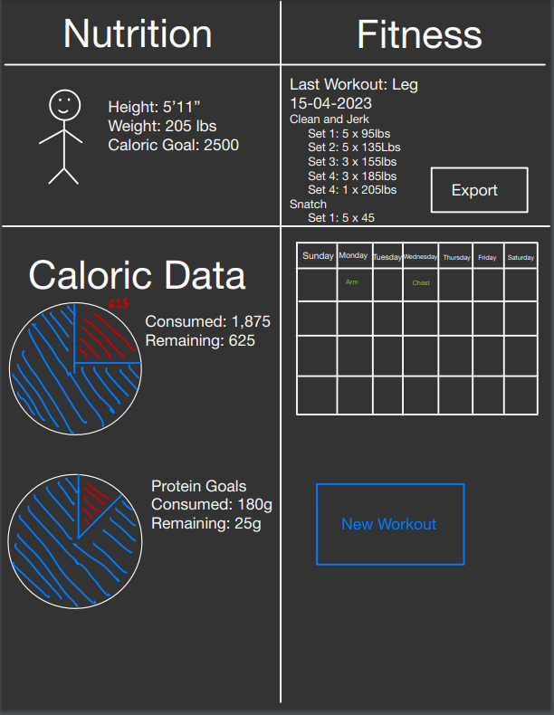
Minimum Viable Product (MVP)
The MVP of this project would be a application that takes in the caloric input of a user and adds that value to the users daily goal. The product should also be able to keep track of a users workout and, allow the user to go back and see their past workouts.
Notes:
Nick

Slide 17
Thank you and Any Question

